Slide 1


Paradise Road
Go on an adventure
Presented by Group-2

Slide 2
1.Leader
Aung Kaung Moe
2.
Myo Kyal Sin Htet
Introducing
Our
Members!
Min Kyi Sin Thant
3.
4.
Phoo Thit Khaing
5.
Shin Bhone Wai
6.
Myint Moe Kabyar

Slide 3
1.Leader
Aung Kaung Moe
2.
Myo Kyal Sin Htet
Introducing
Our
Members!
Min Kyi Sin Thant
3.
4.
Phoo Thit Khaing
5.
Shin Bhone Wai
6.
Myint Moe Kabyar

Slide 4
1.
Aung Kaung Moe
2.
Myo Kyal Sin Htet
Introducing
Our
Members!
Min Kyi Sin Thant
3.
4.
Phoo Thit Khaing
5.
Shin Bhone Wai
6.
Myint Moe Kabyar

Slide 5
1.
Aung Kaung Moe
2.
Myo Kyal Sin Htet
Introducing
Our
Members!
Min Kyi Sin Thant
3.
4.
Phoo Thit Khaing
5.
Shin Bhone Wai
6.
Myint Moe Kabyar

Slide 6
1.
Aung Kaung Moe
2.
Myo Kyal Sin Htet
Introducing
Our
Members!
Min Kyi Sin Thant
3.
4.
Phoo Thit Khaing
5.
Shin Bhone Wai
6.
Myint Moe Kabyar

Slide 7
1.
Aung Kaung Moe
2.
Myo Kyal Sin Htet
Introducing
Our
Members!
Min Kyi Sin Thant
3.
4.
Phoo Thit Khaing
5.
Shin Bhone Wai
6.
Myint Moe Kabyar

Slide 8
1.
Aung Kaung Moe
2.
Myo Kyal Sin Htet
Introducing
Our
Members!
Min Kyi Sin Thant
3.
4.
Phoo Thit Khaing
5.
Shin Bhone Wai
6.
Myint Moe Kabyar

Slide 9
1.
Aung Kaung Moe
2.
Myo Kyal Sin Htet
Introducing
Our
Members!
Min Kyi Sin Thant
3.
4.
Phoo Thit Khaing
5.
Shin Bhone Wai
6.
Myint Moe Kabyar

Slide 10
Booking Page
Introduce
Our
Agency!
Home Page
Also shows available packages and our services!
Login and Registration

Slide 11
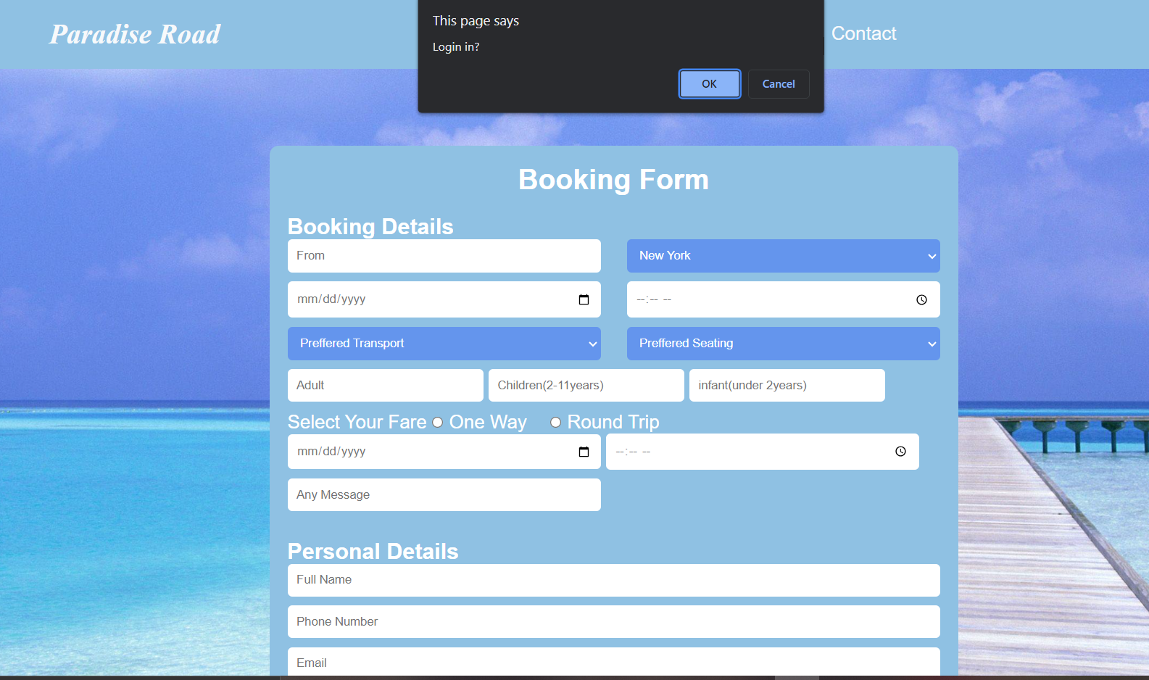
Explore Page
Booking Page
Start your booking now!
Home Page

Slide 12
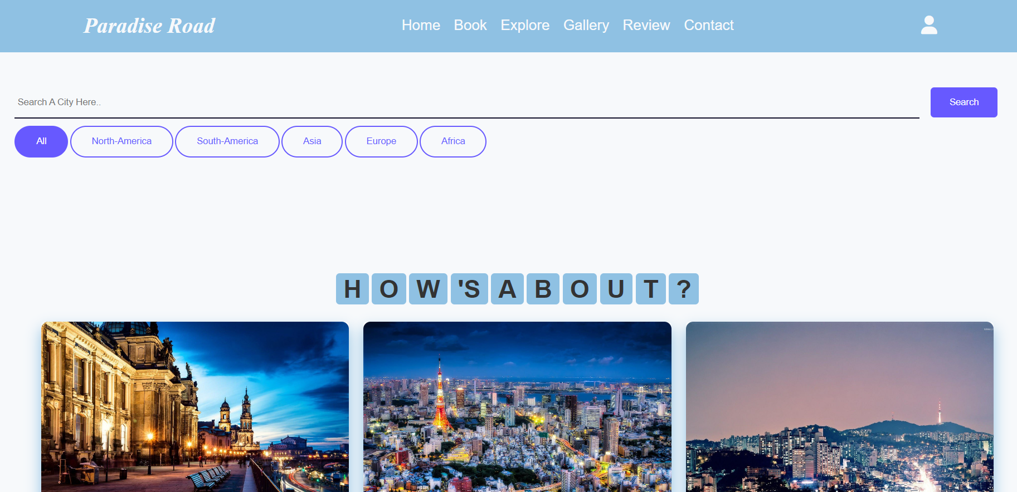
Gallery Page
Explore Page
Search where you wanna go
Booking Page

Slide 13
Review Page
Do you wanna check before starting your booking? Sure!
You can see many photos in gallery page!
Gallery Page
Explore Page

Slide 14
Contact Page
Find out what other tourists said about our agency in Review Page!
Review Page
Gallery Page

Slide 15
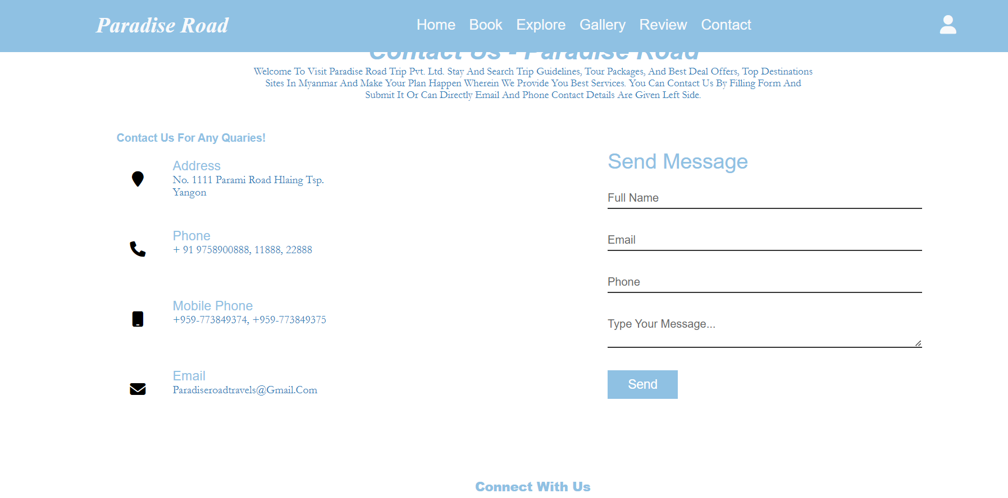
Login and Registration
Contact Page
Type your message and Contact us right now!
Review Page

Slide 16
Home Page
Not a member? Sign up now!
Click the little person icon and
Enter your Name, Email, Create a password and Confirm your password!
Then you can log in now!
Login and Registration
Contact Page

Slide 17
Book
Explore
Login & Sign up
HOME
Gallery
Contact
Review

Slide 18
We created this website with these languages
1.HTML 2.CSS 3.JavaScript

Slide 19
HTML
CSS
Media Query
Flex
Card Design
Form
Video slider

Slide 20
JavaScript
Slider
Login and Register
Validation
Filter & Search

Slide 21
Minimum OS
Requirement to run our Project
For Window, Window 7 is the minumum
Recommend Window 10 for better performance.

Slide 22
Pros and Cons
Pros
Cons
Reponsive
Easy to use
User-friendly
Various Options
Searchable
Can use on any devices
It is fake
No php, database, admin
Only alert box
Login data are lost everytime the page reload

Slide 23


